Slide 1
Our Learning Commons
James Short Memorial School

Slide 2
JSM Background…
What is your current understanding of “Learning Commons”?
Either on your own, or in a small group, fill in this chart:
http://tinyurl.com/qyvylm8

Slide 3
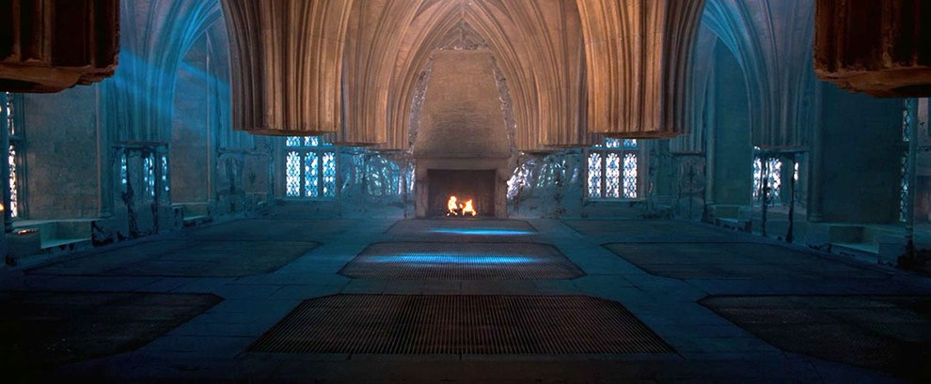
In Harry Potter
The Room of Requirement is a room in Hogwarts that appears to those in great need, containing whatever it is they require.

Slide 4
Imagine…
What would your own room of requirement contain?

Slide 5
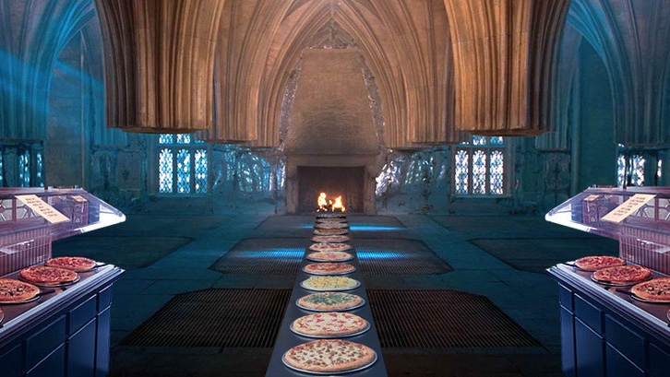
A pizza buffet?

Slide 6
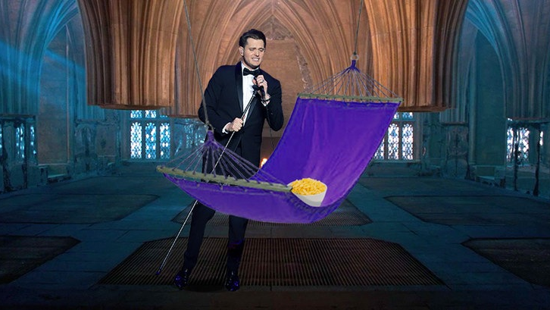
Kraft Macaroni & Cheese, a hammock to nap in, and Michael Bublé performing?

Slide 7
Kidding aside…
In Harry Potter, the room of requirement becomes a place where:
the students can learn and experiment without fear.
students collaborate and learn from each other.
the resources and technology required are at their fingertips
students have autonomy and work towards mastery through feedback loops
learning is authentic and motivating

Slide 8
A Learning Commons is like a “Room of Requirement” for student learning…
Koechlin and Loertscher describe it as “A collaborative physical and virtual environment that invites and ignites participatory learning”

Slide 9
“Keechlin, Rosenfeld and Loerttscher define it as “a learning “space” that is both physical and virtual – a place to experiment, practice, celebrate, learn, work and play.
Saddleridge School describes it as “… a place where everyone is a learner. Learning within the curriculum becomes personalized, individualized, motivating and engaging. The Learning Commons addresses multiple learning styles and needs.”

Slide 10
Ontario School Libraries Association describes the Learning Commons as “a flexible and responsive approach to helping schools focus on learning collaboratively. It expands the learning experience, taking students and educators into virtual spaces beyond the walls of a school.”
“A Learning Commons is a vibrant, whole-school approach, presenting exciting opportunities for collaboration among teachers, teacher-librarians and students. Within a Learning Commons, new relationships are formed between learners, new technologies are realized and utilized, and both students and educators prepare for the future as they learn new ways to learn.”

Slide 11
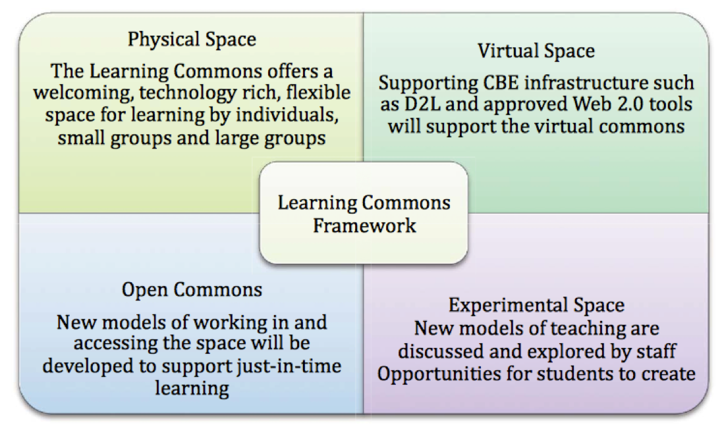
CBE ILS Learning Commons Framework:

Slide 12
Why?
https://www.youtube.com/watch?v=Ax5cNlutAys

Slide 13
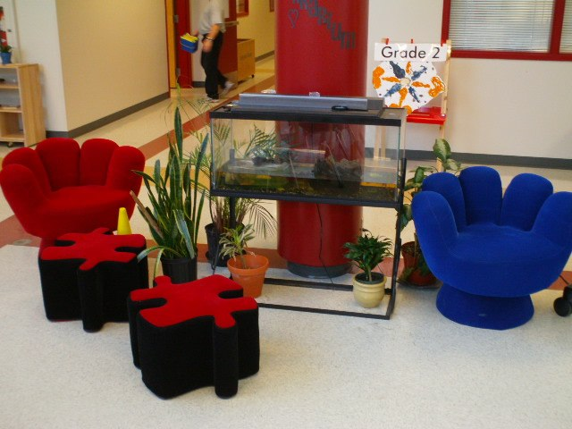
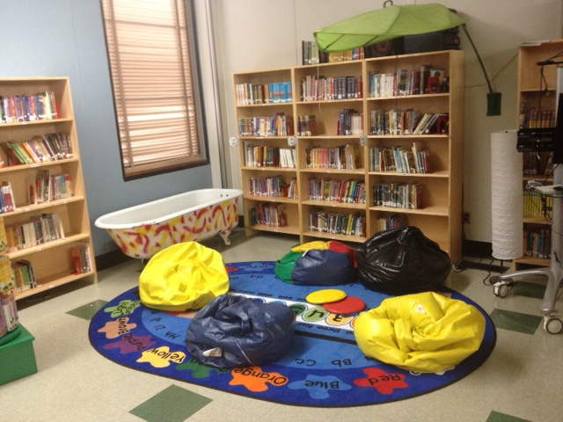

Slide 14
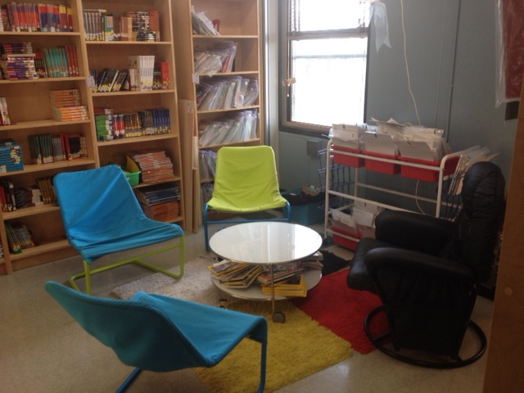
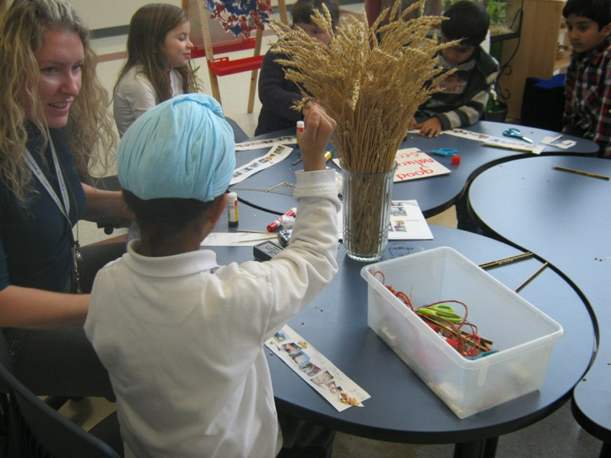

Slide 15
Your task…
At James Short Memorial, considering our students and learning community, what are our Learning Commons requirements? What are the possibilities?
Brainstorm with a group of 2 or 3 people and record your ideas in this Google Doc…
http://tinyurl.com/nuofspt

